Slide 1
Progress report

Slide 2
OutLine
Introduction
Background knowledge
System design
Future work

Slide 3
INTRODUCTION

Slide 4
InTRODuction
Use multiple distinguishable marker and multiple polarization cameras to achieve 3D-motion capture.
https://www.youtube.com/watch?v=YJjuyqYmVlE

Slide 5
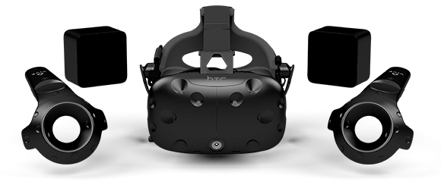
Motion capture
1. 點(Marker)追蹤: 在控制器及裝置上貼滿定位點，再利用固定位置的相機取得點的位置
Company : Vicon, OptiTrack, …
2. 雷射追蹤: 在頭戴裝置及控制器上設置感應器(光敏傳感器)，且需額外架設一組獨立的雷射發射站
Company : HTC Vive

Slide 6

Vicon
https://www.youtube.com/watch?v=YJjuyqYmVlE

Slide 7
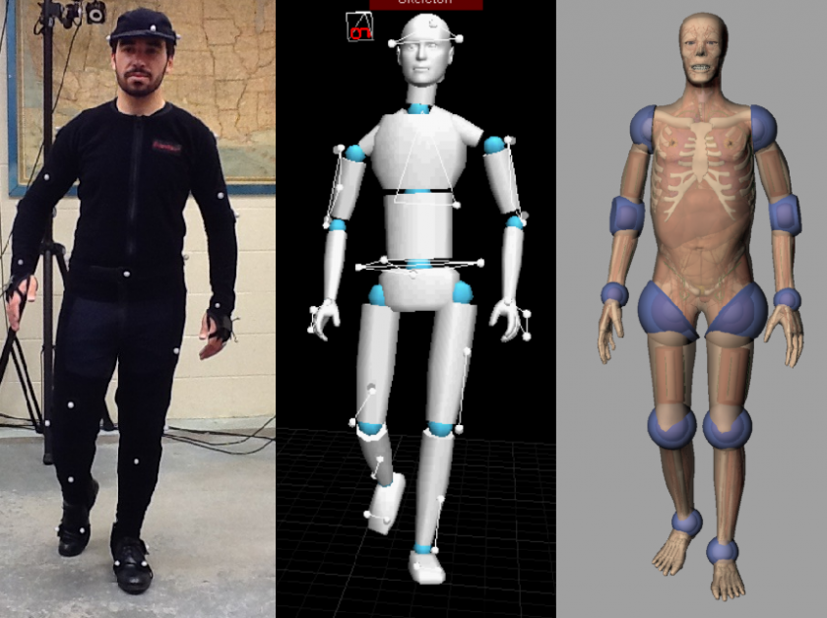
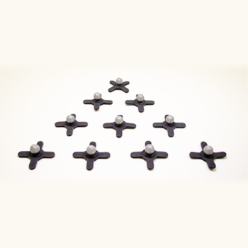
VICON
介紹:
Vicon系統由一組由Gigabit EtherNet網路連接的相機以及其他設備所組成，為一種基於反射式的捕捉系統，需要事先在被捕捉的人或者物體上黏貼反射球(Marker)，經由相機捕捉反射後的紅外線便可計算得出Marker的3D座標‧

Slide 8
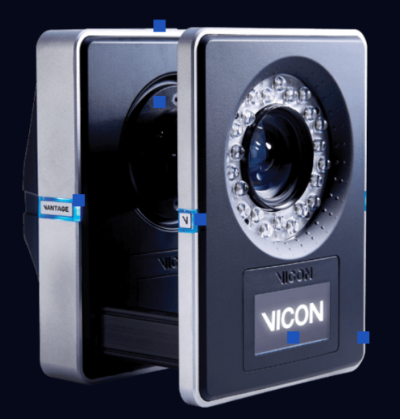
Vicon
相機規格 :
Model | V16 | V8 | V5
Resolution(MP) | 16 | 8 | 5
MAX Frame Rate(Hz) | 120@16MP | 260@8MP | 420@5MP
MAX Frame Rate(Hz) | 2000 | 2000 | 2000
Camera Latency(ms) | 8.3 | 5.5 | 4.7
Shutter Type | Global | Global | Global
Max Power Consumption(W) | 24 | 24 | 12
Weight (Kg) | 1.6 | 1.6 | 1.6

Slide 9
WeakNEss of Marker Tracking
但點追蹤仍具有下列缺點 :
1. 可識別目標數目有限 :
實現一個目標點的姿態捕捉需要至少不共面的4個標識點，以槍戰遊戲為例，如果只對頭部和槍進行定位，每個玩家需要8個標識點。如果需要做全身動作捕捉，標識點數目會大量增加。所以系統通常會限制最大標示點的數目。
2. 遮擋問題 :
系統需要至少兩個相機同時拍到同一標記點才可實現該標記點的定位，而當紅外光線被使用者或物體遮擋時，空間點三維重構就會由於缺少必要的二維圖像中的特徵點間對應信息，導致定位跟蹤失敗
3. 價格昂貴

Slide 10
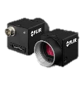

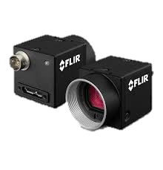
System Overview
Reconstruct 3D model
Capture images
Capture images
Detect & Identify markers
Capture images
feedback
If action is done
Store markers’ information
and
update 3D model
Score user’s action
( tracking )

Slide 11
Detect & ideNtify
Calculate
Polarization
Information
Raw image
Find out area
which looks like a square
Create particles
& spread
Calculate likelihood
Of each particle
Evaluate markers Id

Slide 12
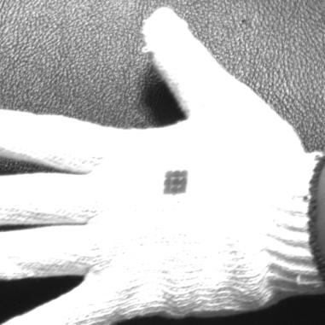
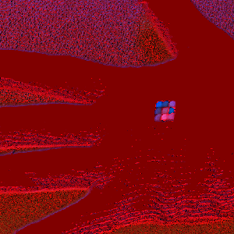

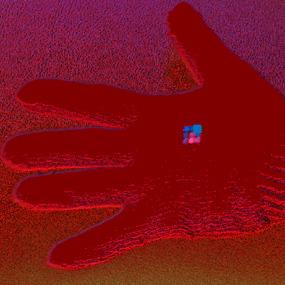
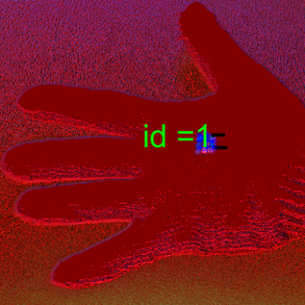
Detect & ideNtify
-4.8652
Id = 1

Slide 13
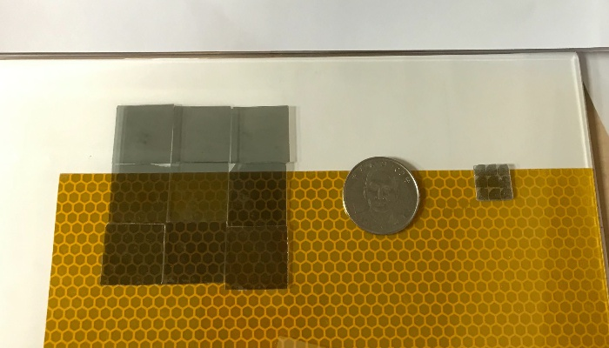
Something Different
Marker Size : Change edge length from 60mm to 12mm

Slide 14
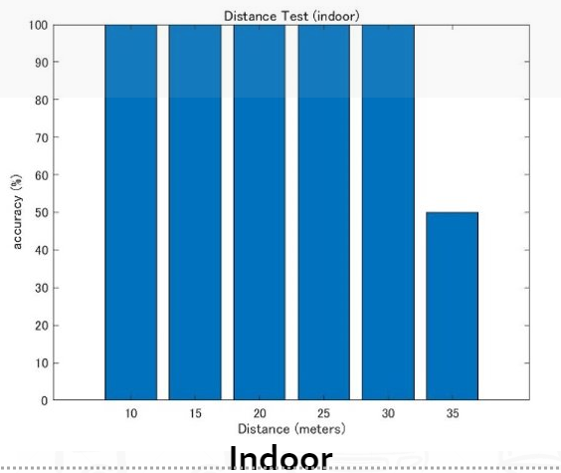
2. Distance : 70 cm
( 0.7 ) * (5 ^ 2) = 17.5(m)

Slide 15
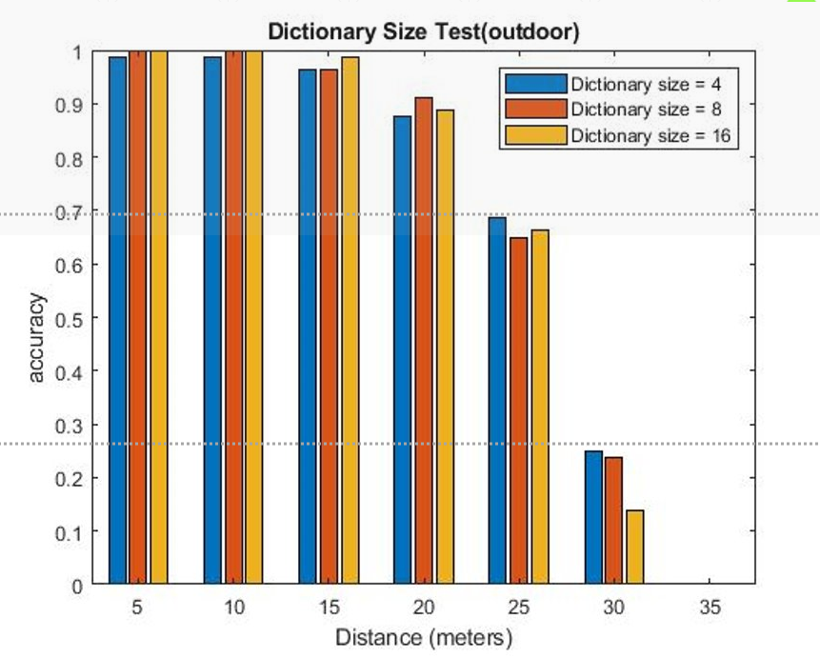
3. Number of ID : change from 5 to 24

Slide 16
4. Moving object

Slide 17
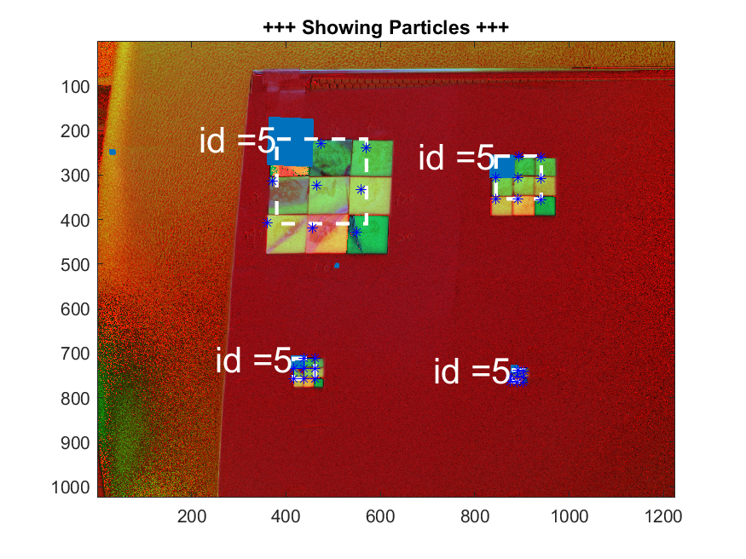
Distance estimation
Distance : 50cm
Edge
length
30mm
60mm
15mm
7.5mm

Slide 18
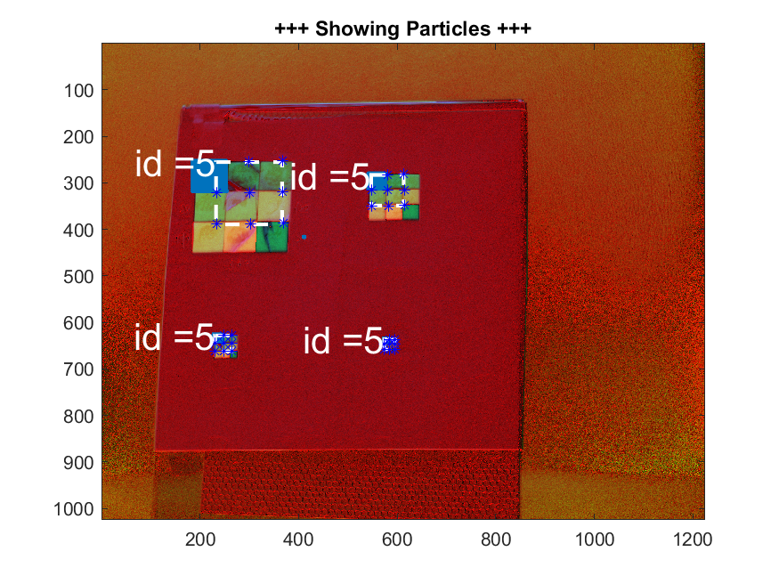
DISTANCE ESTimation
Distance : 70cm

Slide 19
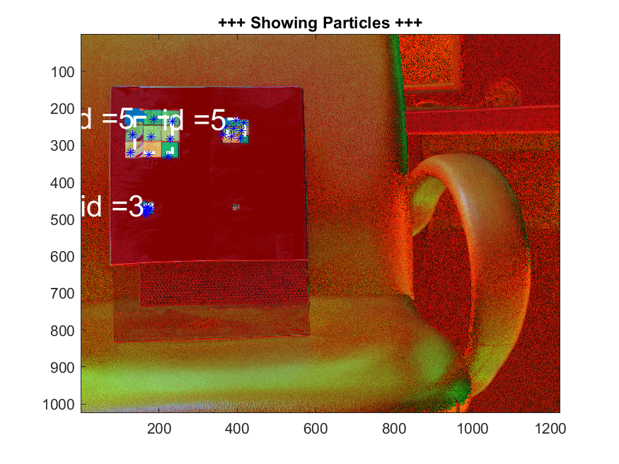
DISTANCE ESTimation
Distance : 100cm

Slide 20
Minimum differential angle
Scene :
1. Polarizer on the board
2. Polarizer on the slowly rotate chair
3. Polarizer on the slowly moving hand
4. Polarizer on the moving hand

Slide 21
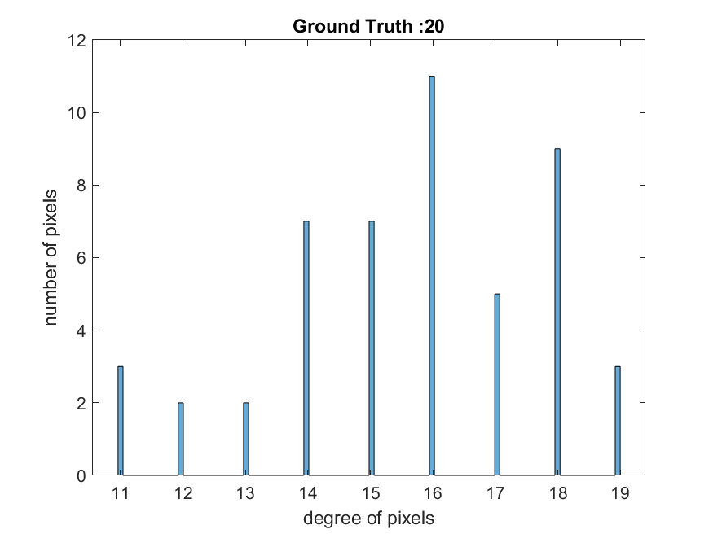
Board
Detected value : 15

Slide 22
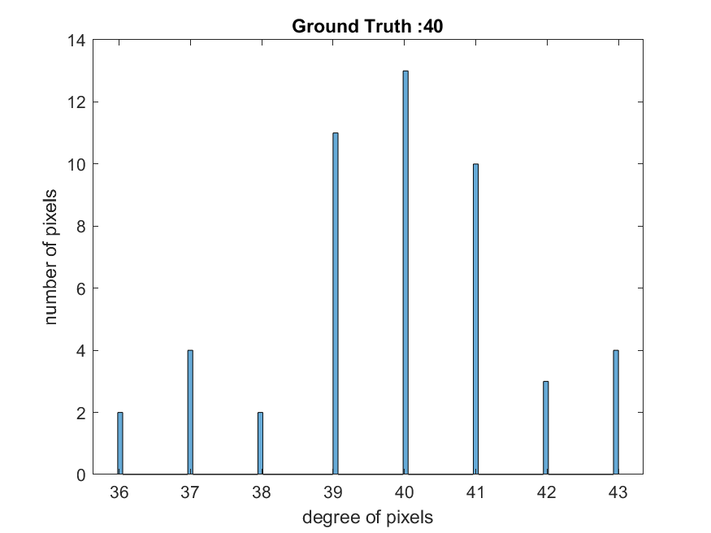
Board
Detected value : 39

Slide 23
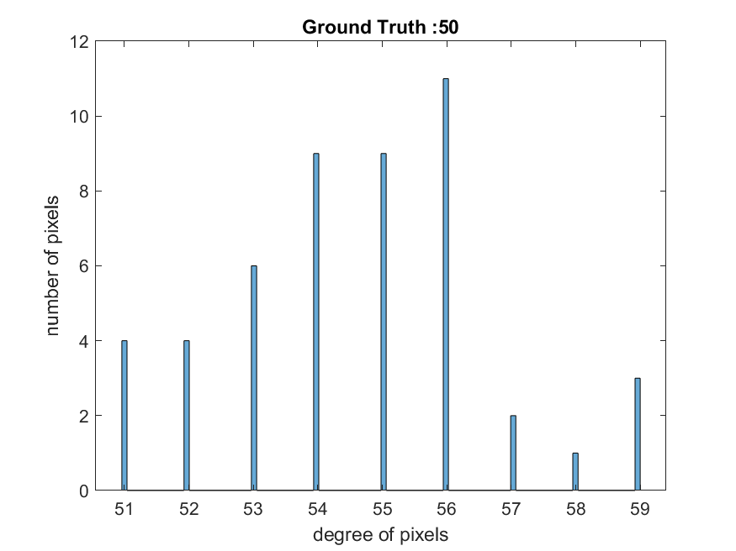
Board
Detected value : 56

Slide 24
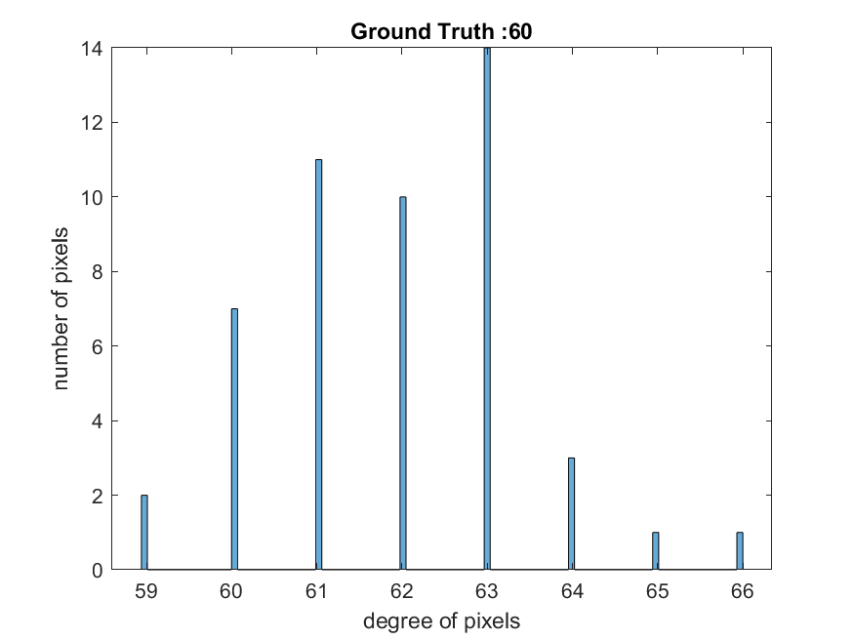
Board
Detected value : 62

Slide 25
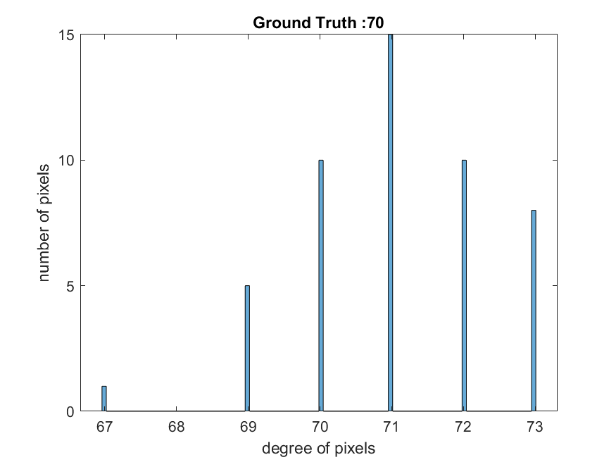
Board
Detected value : 73

Slide 26
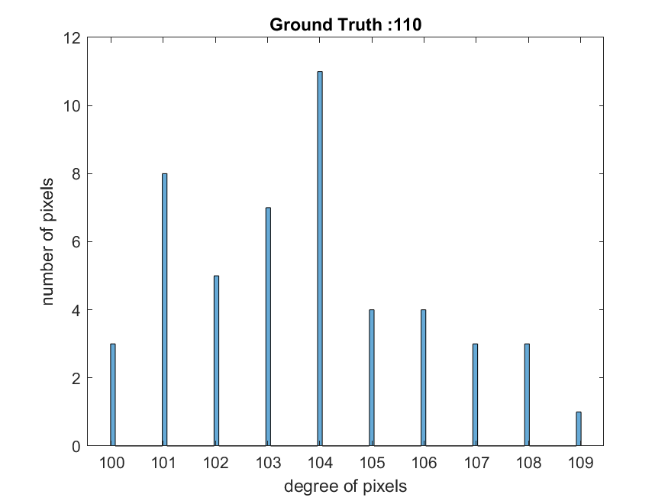
Board
Detected value : 104

Slide 27
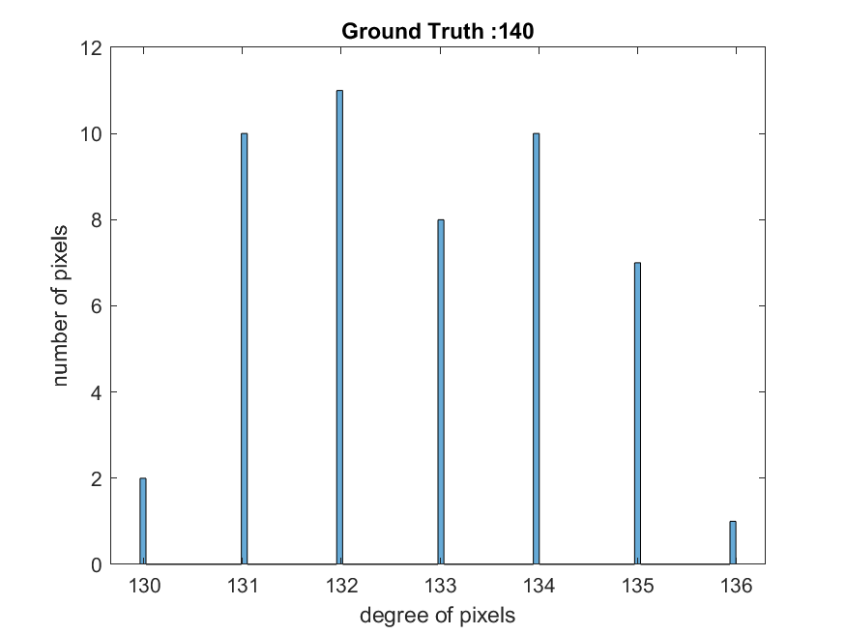
Board
Detected value : 135

Slide 28
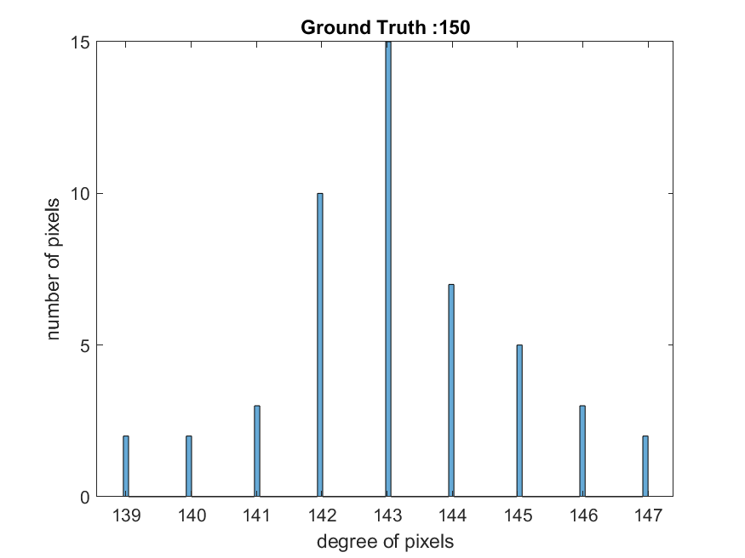
Board
Detected value : 144

Slide 29
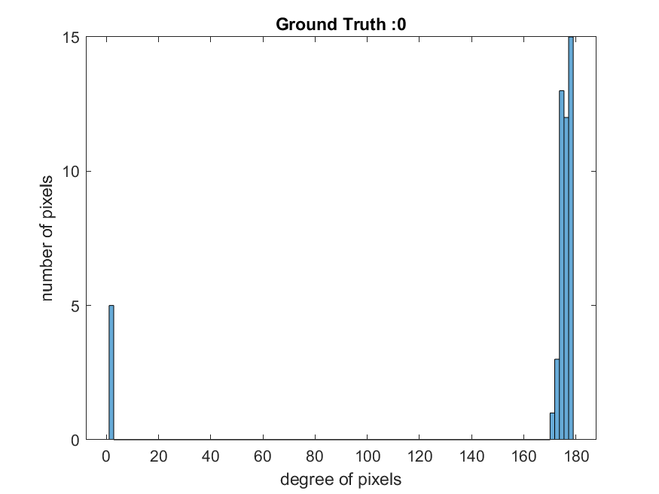
Board
Detected value : 174

Slide 30
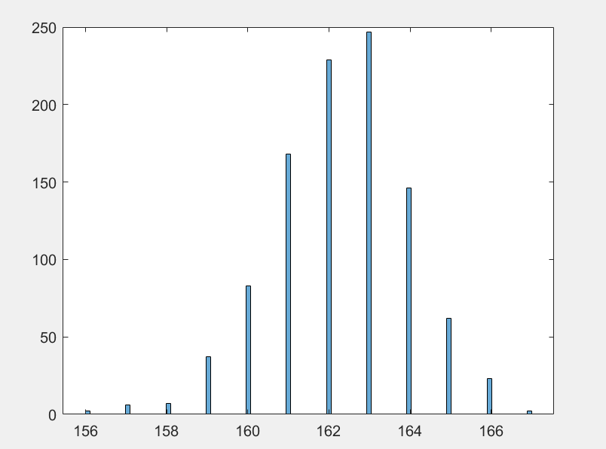
Slowly rotate chair
Ground Truth : 160
#
of
pictures
Degree

Slide 31
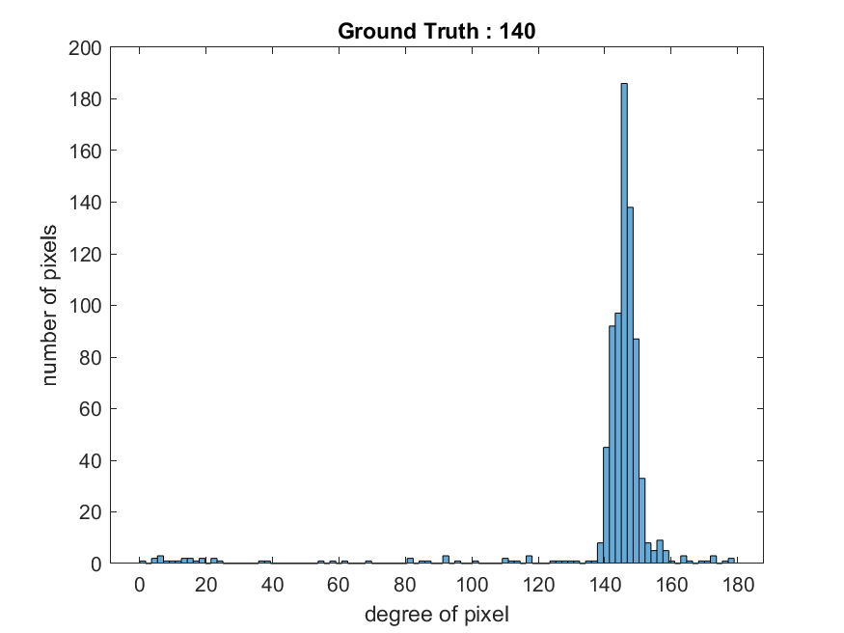
SLOWY MOVING HAND
#
of
pictures

Slide 32
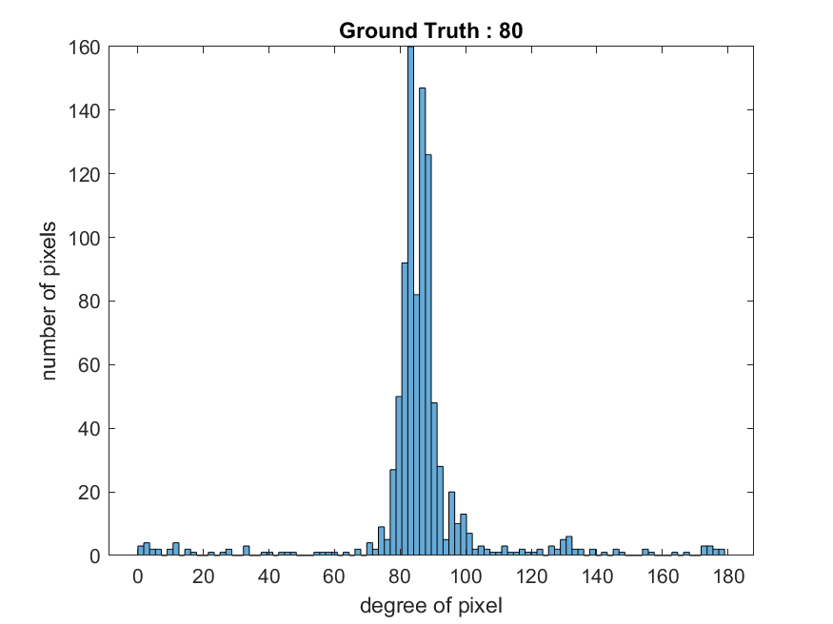
Normal speed

Slide 33
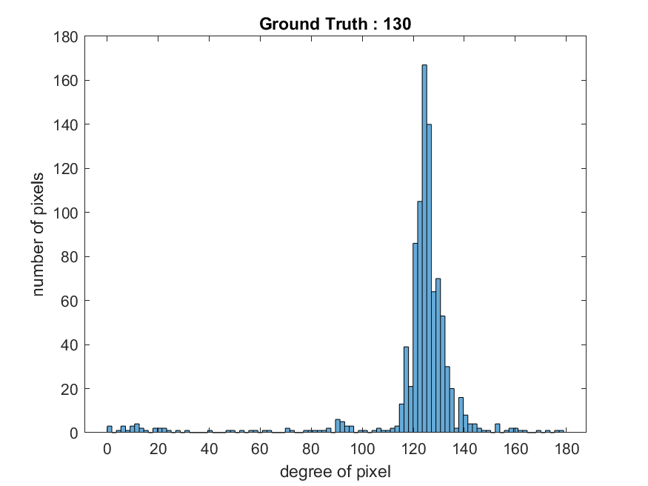
Normal speed

Slide 34
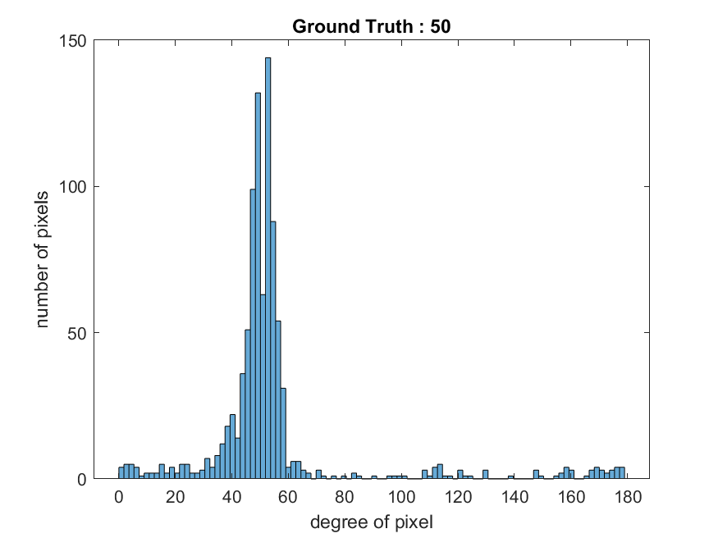
Normal speed

Slide 35
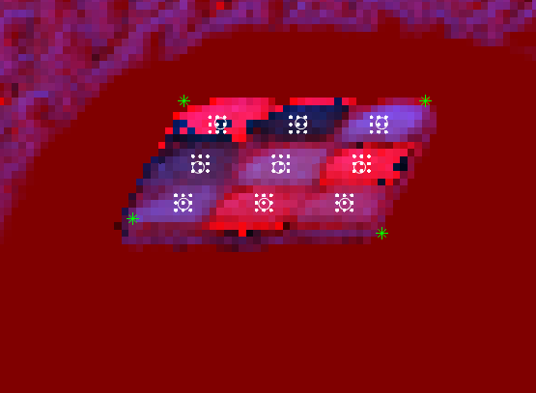
Slope marker

Slide 36
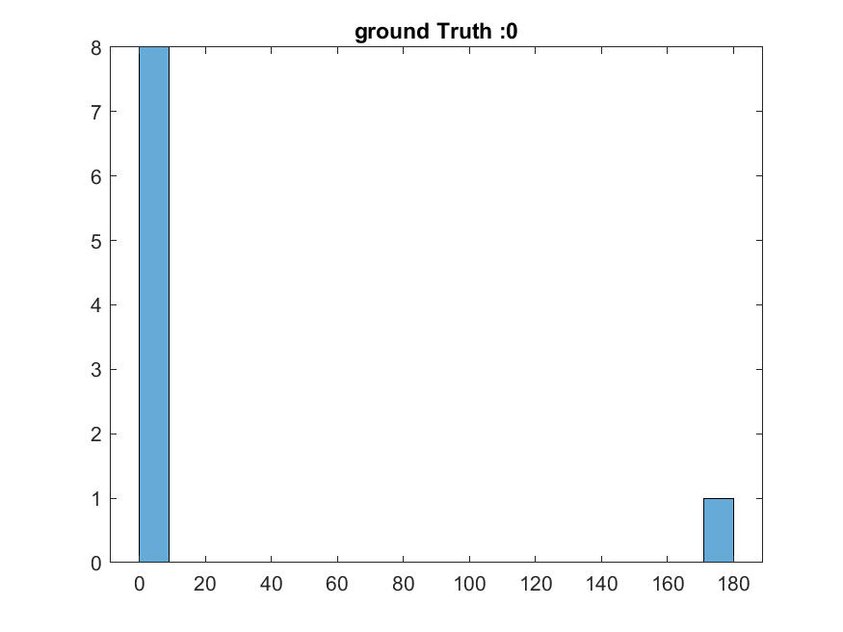
Slope marker

Slide 37
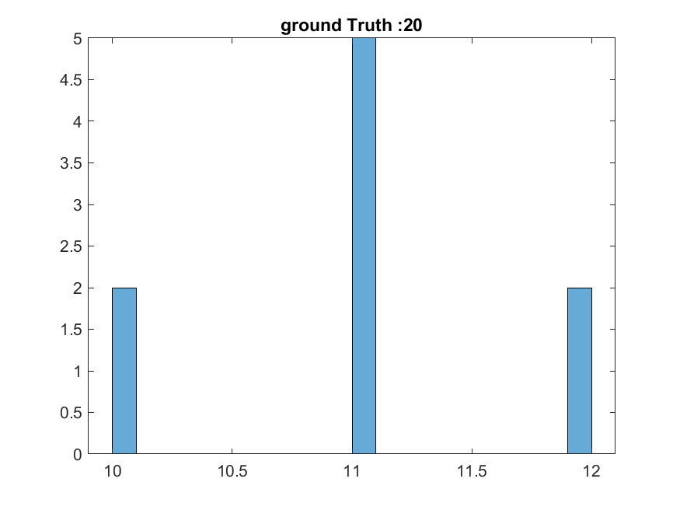
Slope marker

Slide 38
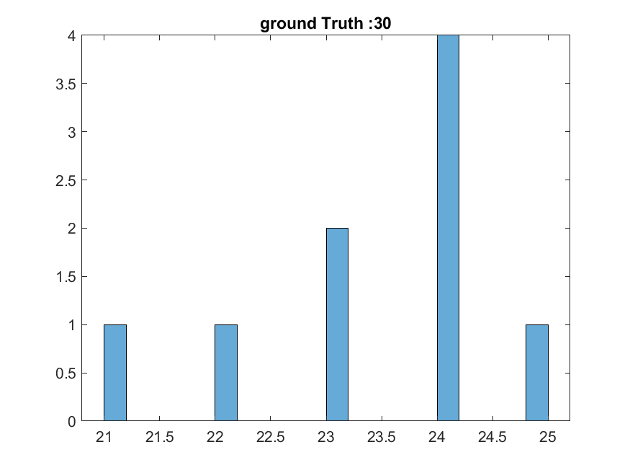
Slope marker

Slide 39
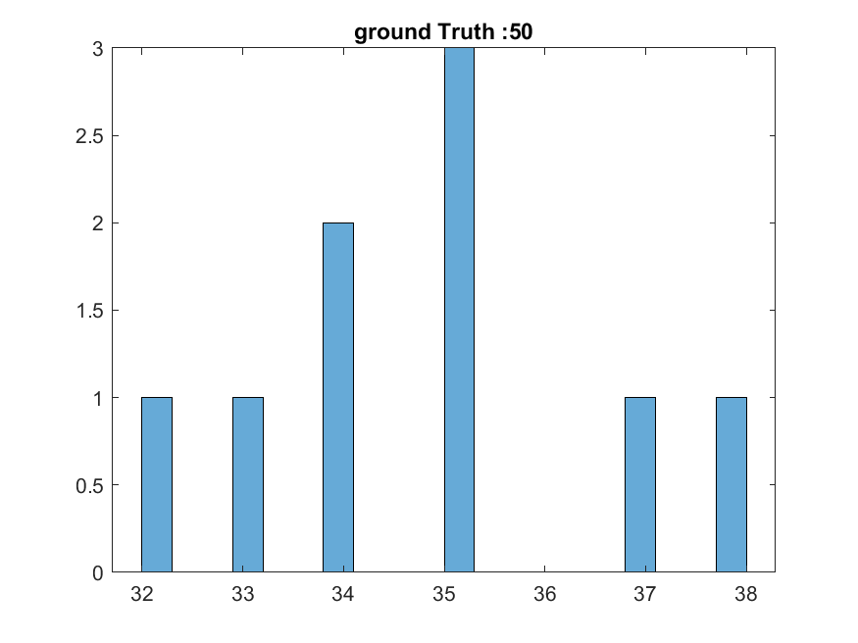
Slope marker

Slide 40
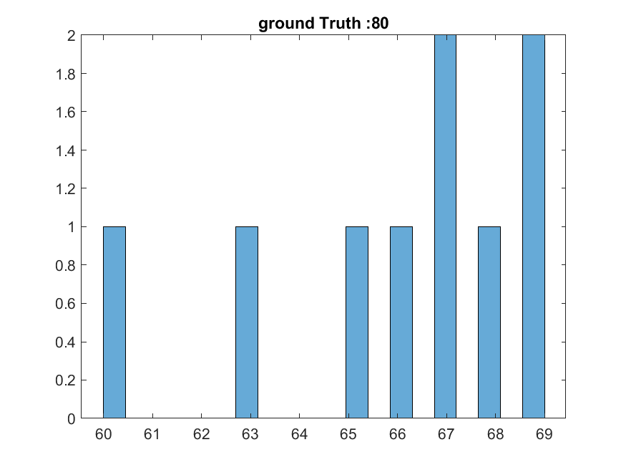
Slope marker

Slide 41
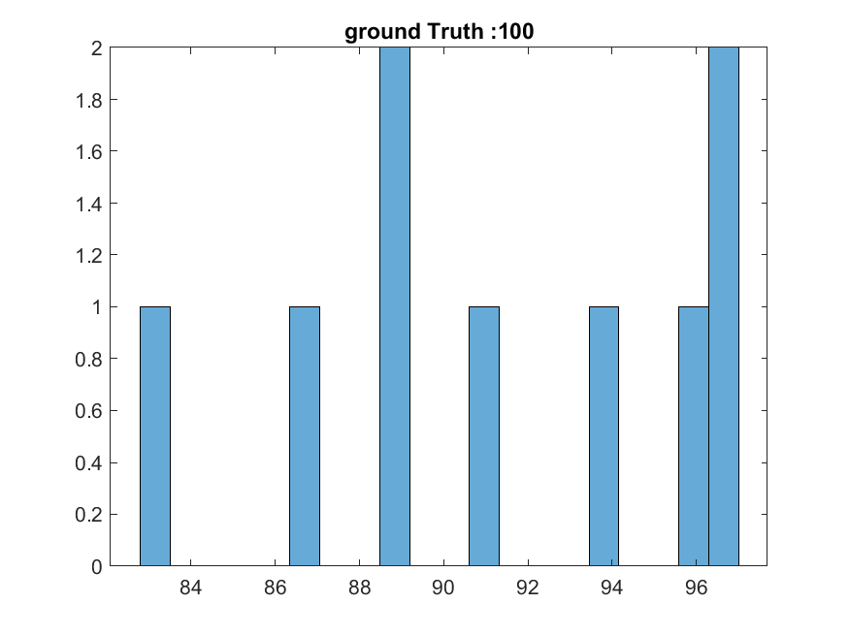
Slope marker

Slide 42
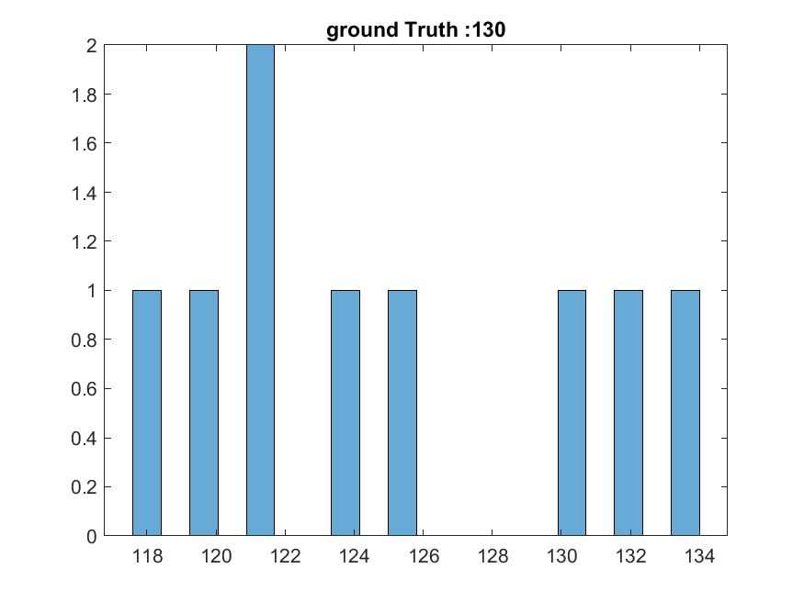
Slope marker

Slide 43
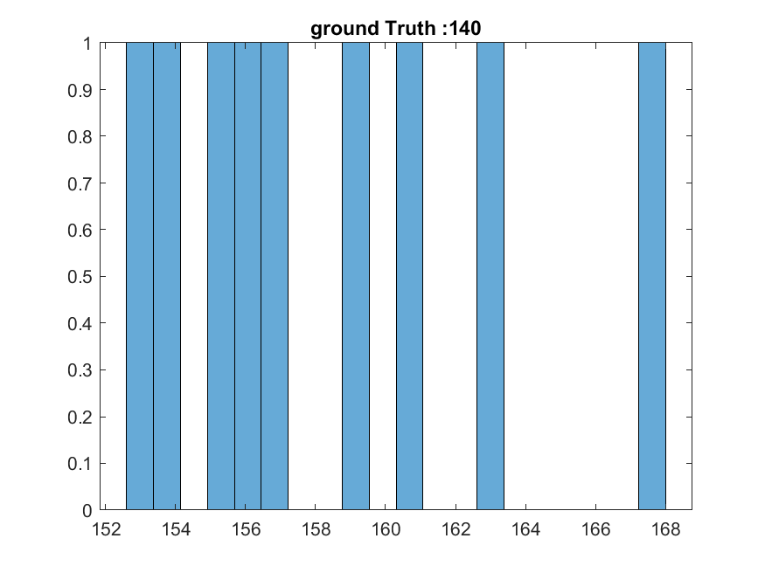
Slope marker

Slide 44
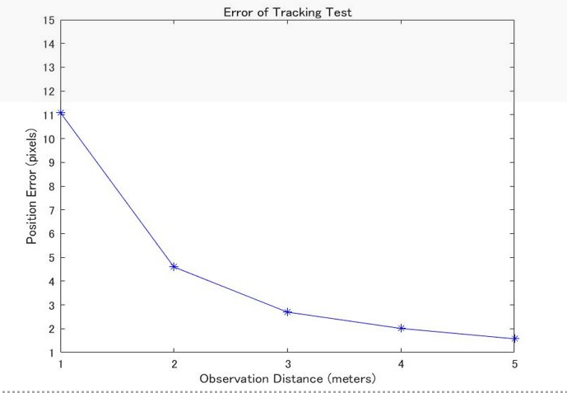
Tracking

Slide 45
Tracking
Challenge : Since path of particles are unpredictable, we could not find the marker’s position exactly.

Slide 46
Tracking
could all be possible marker position
error

Slide 47
Future work
1. Implement 2D marker tracking
2. extend current ID dictionary
3. find out reasons which make maker identification incorrect

